Slide 1

Module 4
Process and filesystem
Notes:
Keep to agenda
Know your students
Check retention periodically
Employ visual aids
Use various teaching techniques
Use real-life scenarios
Use positive reinforcement

Slide 2
Outline
Understanding nodejs process
Handling global exceptions
Working with local filesystem
Watching filesystem for changes
Buffers

Slide 3
Process - Official Site Says
The process object is a global that provides information about, and control over, the current Node.js process
The process object is an instance of EventEmitter

Slide 4
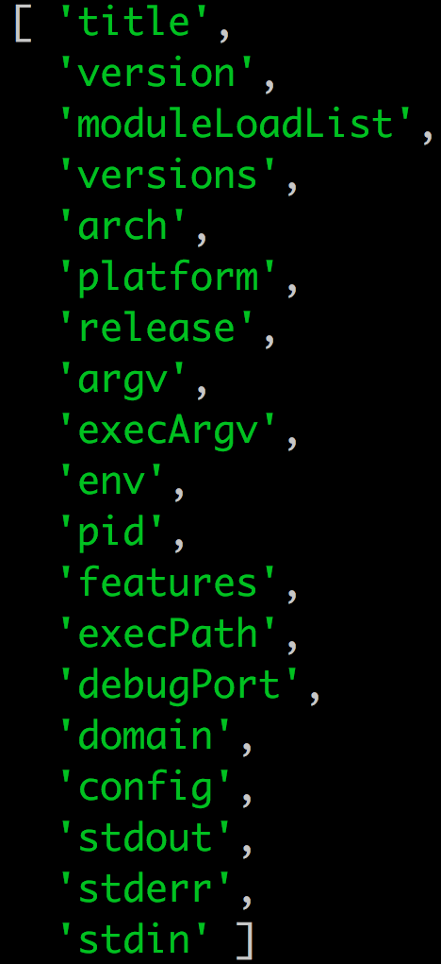
Process - Properties

Slide 5
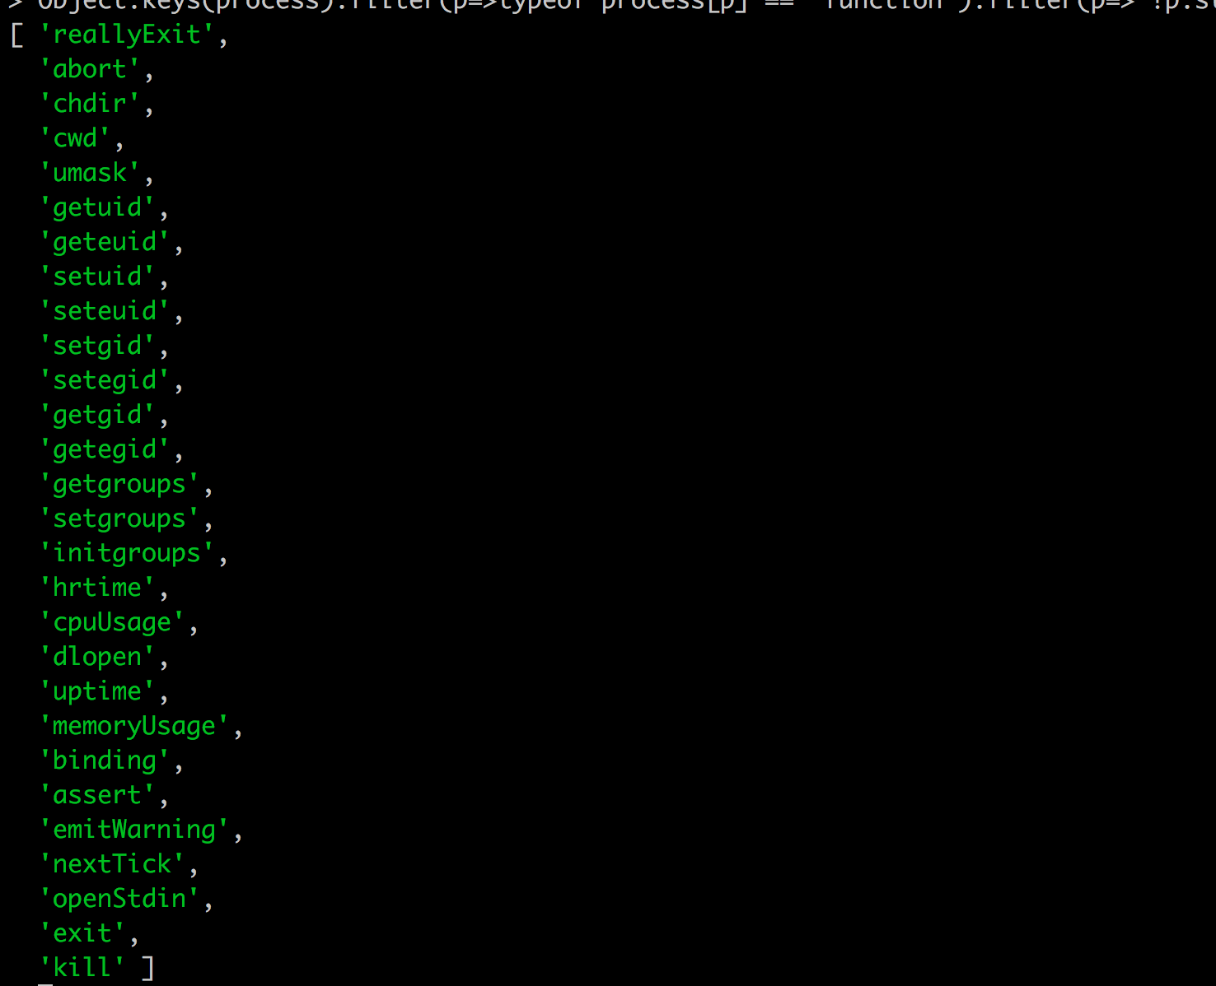
Process - Methods

Slide 6
Process - Events
beforeExit
disconnect
Exit
Message
uncaughtException
unhandledRejection
warning

Slide 7
Process - Streams
process.stdin
process.stdout
process.stderr

Slide 8
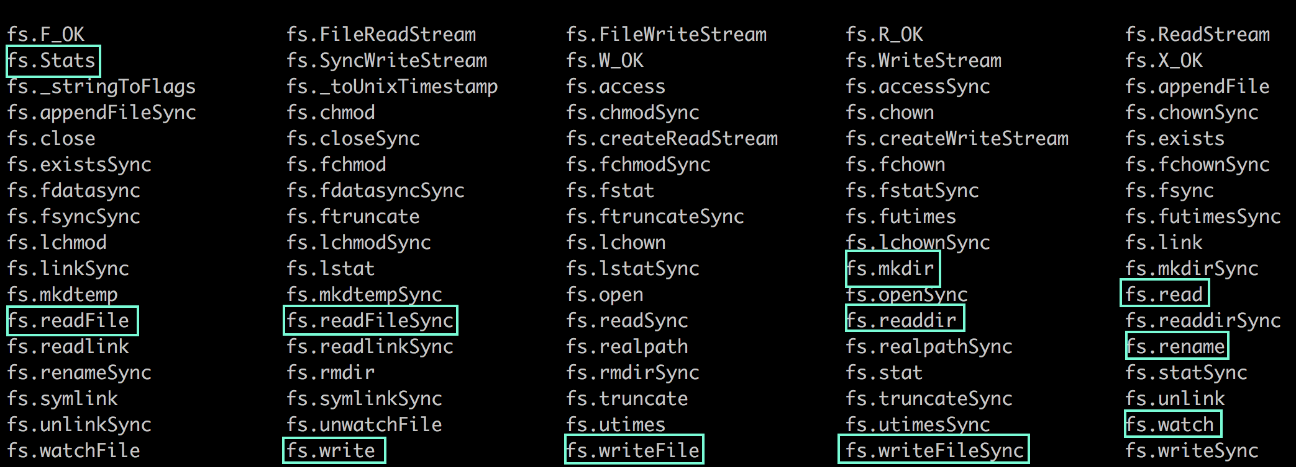
FileSystem - with node

Slide 9
Creating, Copying, Deleting files
fs.createWriteStream - create file
fs.createReadStream.pipe(fs.createWriteStream) - copy file
fs.unlink - delete file

Slide 10
Creating, Copying, Deleting Directories
fs.mkdir - create directory
No direct methods - copy directory
fs.rmdir

Slide 11
Watching file changes
fs.watch
Watch for changes on filename, where filename is either a file or a directory. The returned object is a fs.FSWatcher.

Slide 12
Buffer
JavaScript language had no mechanism for reading or manipulating streams of binary data
Buffer class was introduced as part of the Node.js API to make it possible to interact with octet streams in the context of things like TCP streams and file system operations

Slide 13

Summary
Process Object
Working with File System
Watching for file changes

Slide 14

Check your knowledge
Which filesystem function is used to be notified about file changes ?
Which node module provides file system functionalities?
How can we access environment variables in node?
Which filesystem function is used to delete a file?
How to handle exception that bubbled up to process level?

